Slide 1
Put local registry in Kubernetes cluster

Slide 2
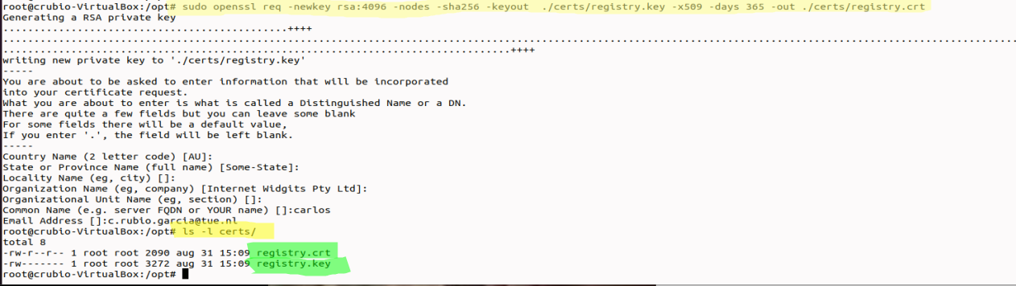
Generate certificates for everything

Slide 3
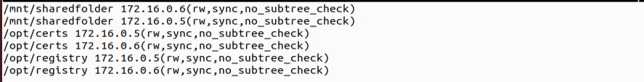
Install NFS to share data among Master and Worker nodes’(in our server will be iscsi)
Followed Vitux guide to mount a shared volume between my master node (Where I store certificates) and my two worker nodes
Guide is quite good, I just have to make sure to:
Put the correct folder names
Give permissions to the folders
EDIT /ETC/EXPORTS file correctly!!! (One entry per folder)
https://vitux.com/install-nfs-server-and-client-on-ubuntu/

Slide 4
Install NFS to share data among Master and Worker nodes (2)
Guide is quite good; I just have to make sure to (2):
Execute the command sudo exportfs –a and systemctl restart nfs-kernel-server to apply changes
Kubernetes by default has firewall (ufw) disabled. Normally, the NFS should work with this disabled. Still, maybe it is needed to create firewall rules to allow connections (like shown in guide). Because I had problems, I enabled the firewall, Applied the rules, and mounted the nfs volumes (After that, Kubernetes was down, I had to unable ufw again for it to work, but when I did that, mounted volumes were working fine). I assume it should work with all firewall disabled.
https://vitux.com/install-nfs-server-and-client-on-ubuntu/

Slide 5
Install NFS to share data among Master and Worker nodes (3)
Guide is quite good, I just have to make sure to (3):
On worker nodes, install nfs-common
Create the folder where the information shared form master node will be
Execute command sudo mount serverIP:/exportFolder_server /mnt/mountfolder_client
For my personal cluster, it was:
Gotta say that folder must be created before mounting the master node shared folder
With all of these steps, NFS folders should work, and the certificate that is in master node should be available in worker node.
https://vitux.com/install-nfs-server-and-client-on-ubuntu/

Slide 6
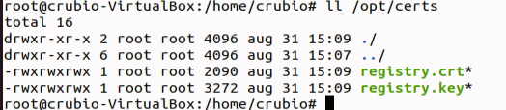

Create Docker Local registry with Kubernetes Deployment yaml file
In the yaml file, make sure that all of the routes are correct. For me, registry.crt and registry.key are placed in:
/opt/certs
/opt/registry
Registry folder seems like it needs to be empty
I had some trouble that permission to access registry.crt was denied. That is because when I created certificate, it did not have read permissions. I executed chmod 777 and gave all permissions. After that, the worker node was able to read them and work fine. Seems to me like a security fail, but if not, it did not work. Need to discuss.

Slide 7
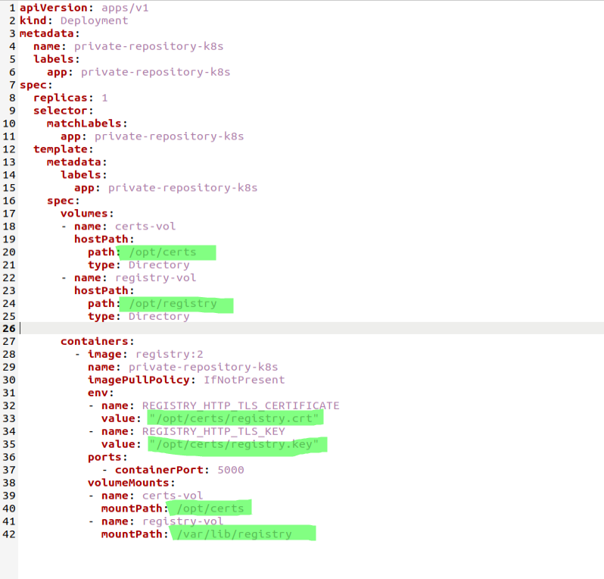
Create Docker Local registry with Kubernetes Deployment yaml file
Need to make sure that routes are correct in the deployment yaml file.
Once the file is correct, execute command:

Slide 8
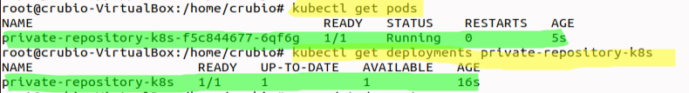
Create Docker Local registry with Kubernetes Deployment yaml file
By following previous steps, I was able to bring up a local docker registry in Kubernetes.
From now on, next steps is to apply services, so docker local registry can be accessed and used properly by the pods.

Slide 9
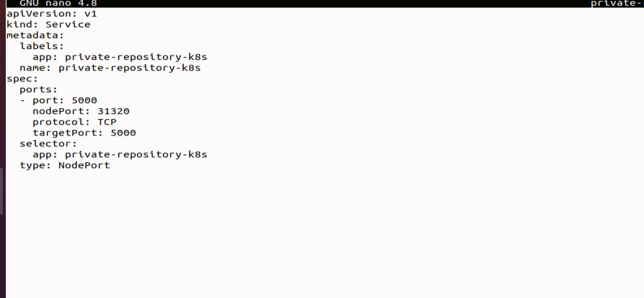
Create service for docker registry
Execute command kubectl create -private-registry-svc.yaml

Slide 10
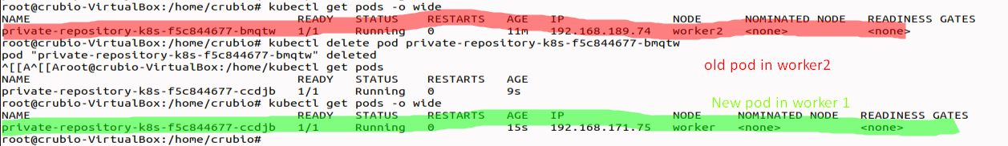
Create service for docker registry
Service should be active now. It maps everything that goes to port 5000 (the one of docke registry) to port
31320 (set up in service yaml file)
Local registry should be running now on Kubernetes. If pod is deleted, it will be created again (in the same worker,
or maybe a different one)

Slide 11
Doubts
If you manage to deploy a container in Kubernetes, say Docker registry or Ozone. This container is running in a pod that runs in one of two worker nodes (ej. Worker node #1 with IP 172.16.0.5) in port 31320; How do you access the service?
-With localhost:31320
With 172.16.0.4:31320 (IP of master node)
With 172.16.0.5:31320 (IP of worker node #1)
172.16.0.6:31320 (IP of worker node #2) also works, IDK why.
They all work because in my deployment yaml file I put metadata:label:app “private-repository-k8s”, and in my service file, I put that the service targets any TCP port 31320 in any pod with the app=“private-repository-k8s” label. That means, every time I do a call with an IP that belongs to the cluster, my cluster will look for any pod within cluster with app label “private-repository-k8s”, and when it finds it, it connects to it.

Slide 12
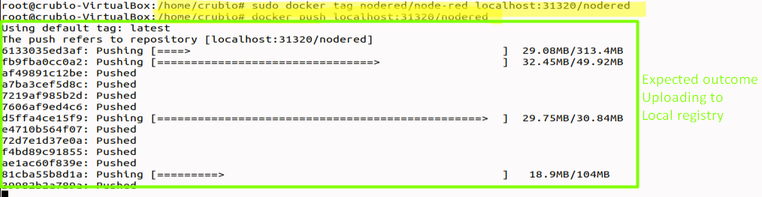
Check registry is UP and running
I verify that registry is empty
Download image from Docker hub
Test image and make a change for testing (explained in next slide how it works)
Tag with my local registry
Push to local registry

Slide 13
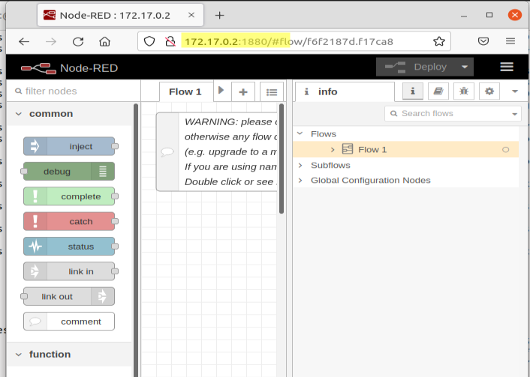
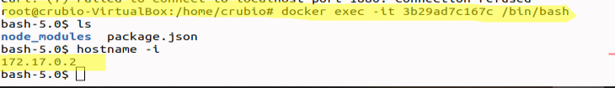
Problems checking registry
When I run the docker container of nodered, just using command docker run nodered/node-red , it automatically should work on localhost:1880. However, for me it is not working.
I think it is something related to Kubernetes running in the same machine as docker, and somehow it affects the ability of docker to work isolated.
I executed command docker exec –it <containerID> /bin/bash to log in inside container. Afte that, I executed command hostname –i to find the IP of container (I need it to be able to use application in browser).
Once found, I can use it in browser to access Nodered in browser with IP:port.
MAYBE IT HAPPENS BECAUSE LOCALHOST IS ALREADY IN USE BY KUBERNETES

Slide 14
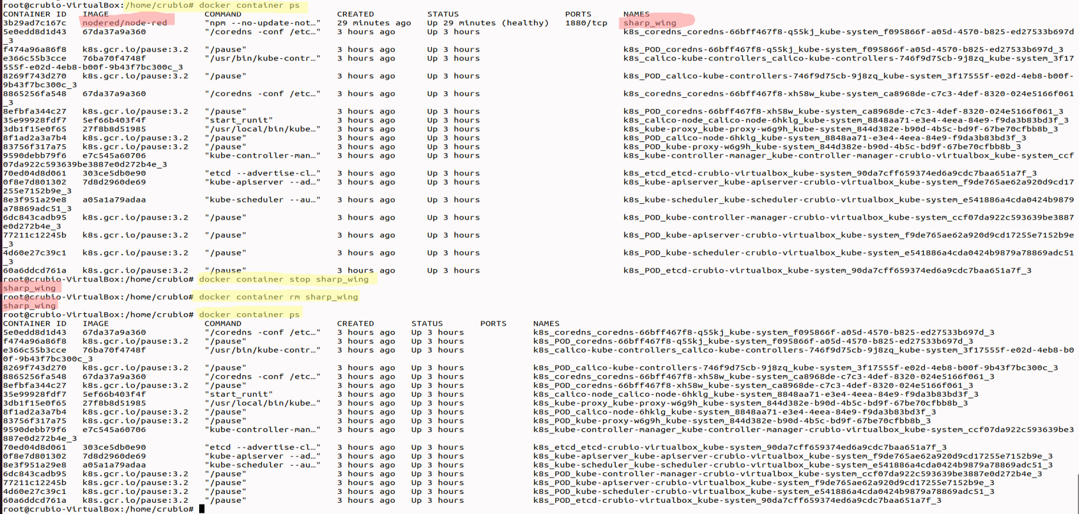
Delete container downloaded from dockerhub

Slide 15
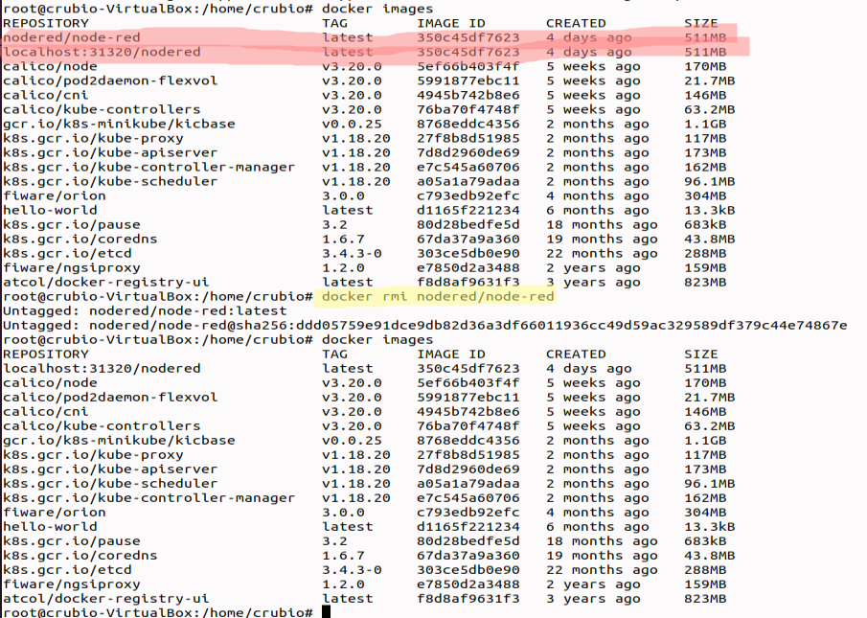
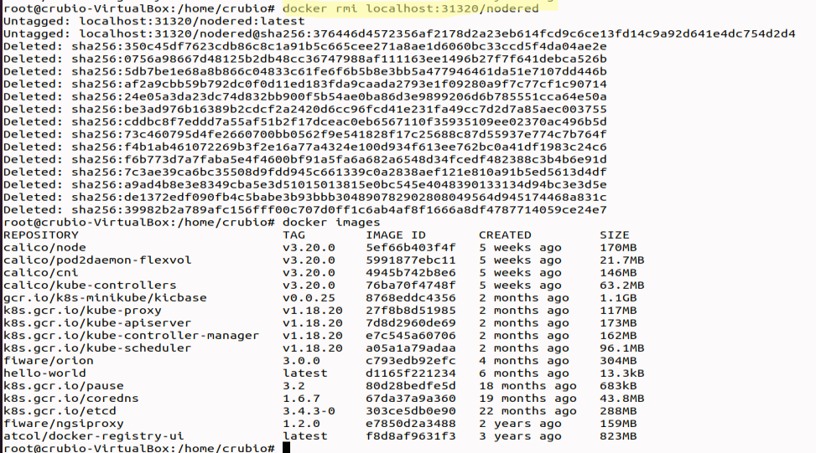
Delete images of Nodered (the one from dockerhub and the one from local registry)

Slide 16
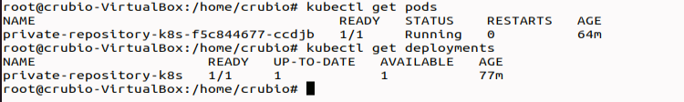
Check that docker local repository is still up

Slide 17
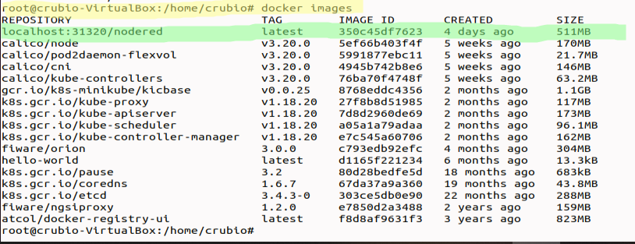
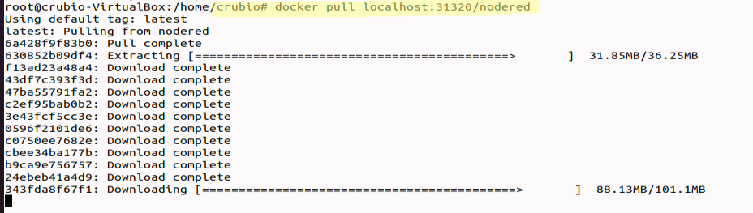
Pull images from local docker registry

Slide 18
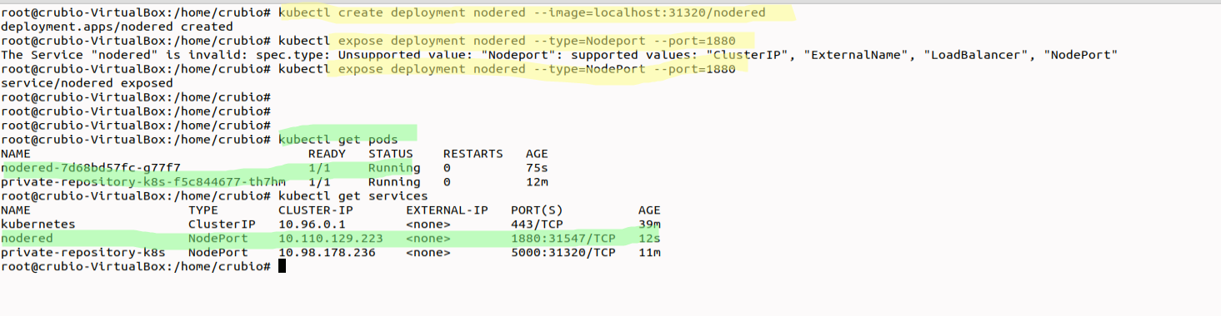
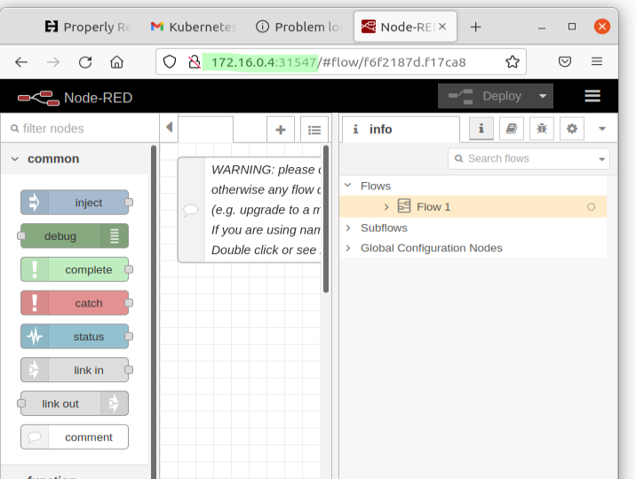
Run container of nodered coming from local registry (WORKS) in Kubernetes POD
To Access this kind of things, always use the IP of the master node.
Eventually, if a DNS (or ingress) is added, an URL will be enough.

Slide 19
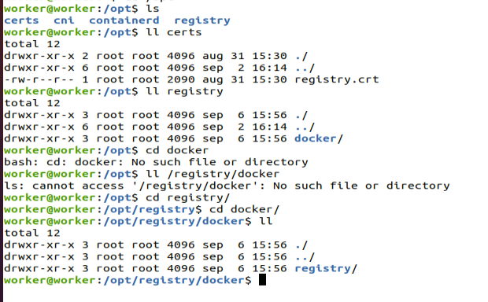
Check of registry stored in local folder defined in yaml file /opt/registry

Slide 20
Only problem
Cannot get to the docker local repository to check which images it has. I can pull and push but cannot do curl to check what images I have.
Every time I restart 3 VM, NFS does not work, worker node cannot find certificates, and indeed, the pod that contains the local registry cannot work.

